Slide 1
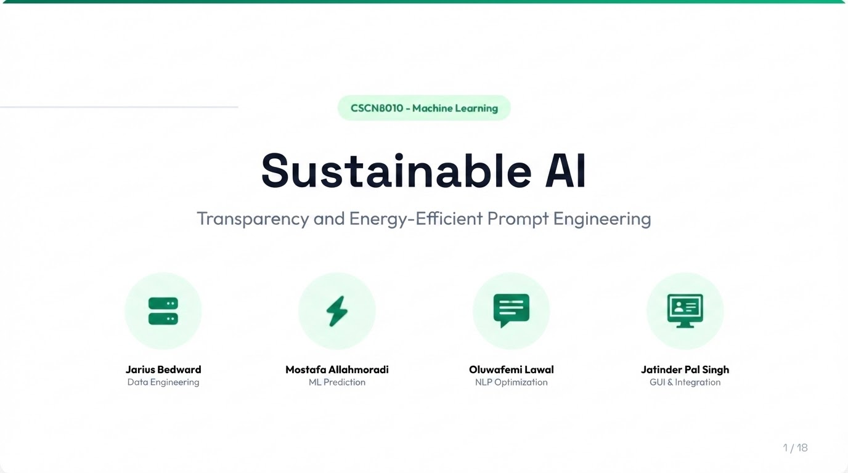

Slide 2



The Challenge & Solution
The Problem
Explosive Growth: 1,240+ new data centers in 2025.
Hidden Costs: Users have zero visibility into prompt energy usage.
Regulation: EU AI Act mandates reporting by 2026.
Our Solution
Predict: ML estimates for kWh & Carbon.
Optimize: NLP rewrites prompts for efficiency.
Visualize: Real-time transparency dashboard.

Slide 3

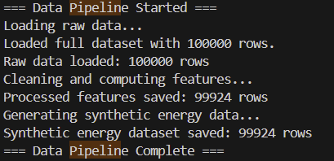

Data Pipeline Architecture
Flow: Input to Insight
We engineered a synthetic data pipeline to bridge the gap between text inputs and physical energy metrics.
Synthetic Data Engine
Overcoming the lack of public energy datasets by generating controlled training scenarios.
Feature Extraction (Linguistic & Hardware)
MinMax Normalization
80/20 Train-Test Split

Slide 4
Feature Engineering
Input Vectors (X)
We combine hardware constraints with linguistic complexity.
Feature | Description | Source
num_layers | Number of model layers | User Input
training_hours | Training time (hours) | User Input
flops_per_hour | Computational intensity | User Input
token_count | Number of tokens in prompt | NLP Extraction
avg_word_length | Average word length | NLP Extraction
energy_kwh (Target) | Energy consumption | Training Data

Slide 5






Data Processing & Logging
Synthetic Dataset
Normalization
Privacy Logging
Generated energy_dataset.csv to train our predictive models on diverse hardware profiles.
Applied MinMaxScaler to ensure Token Counts (0-1000) don't overpower FLOPs (1e18).
Prompts are SHA-256 hashed. We log the energy cost, not the user's secrets.

Slide 6
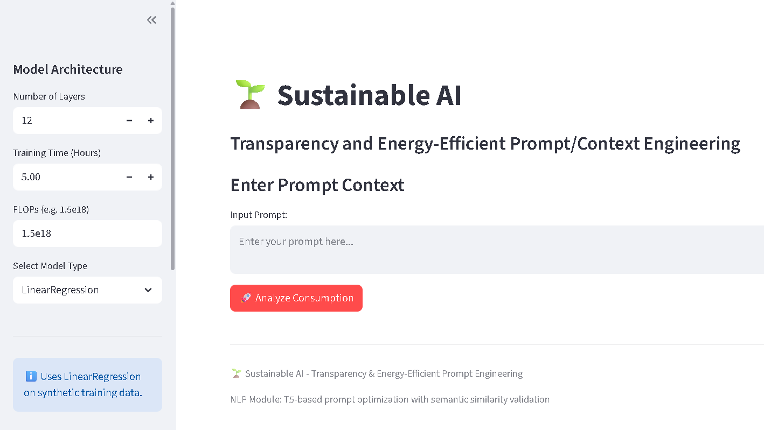
GUI and Integration

Slide 7
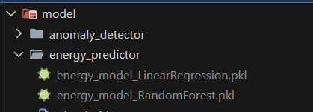
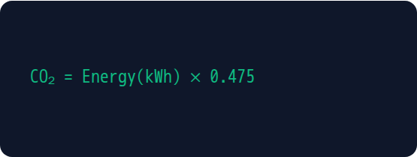
Energy Prediction Engine
Real-Time Inference
The EnergyEstimator class loads pre-trained .pkl models to deliver instant feedback.
Carbon Formula
Based on global grid average intensity.

Slide 8

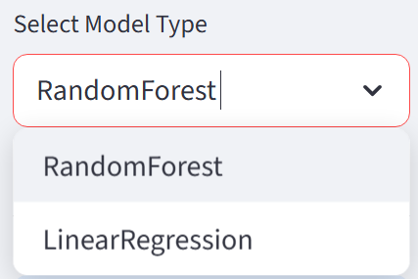
Machine Learning Models
Dual Model Approach
We implemented two regressors to balance accuracy and interpretability.
Random Forest (Primary):
100 estimators. Captures non-linear relationships between token complexity and energy.
Linear Regression (Baseline):
Provides specific feature weights for explainability.

Slide 9

Anomaly Detection
Unsupervised Guardrails
We use Isolation Forest to identify prompts that deviate statistically from normal resource usage.
Use Cases
Detecting "Infinite Loop" prompts.
Flagging inefficient context stuffing.
Alerting on token spikes (Contamination: 5%).

Slide 10
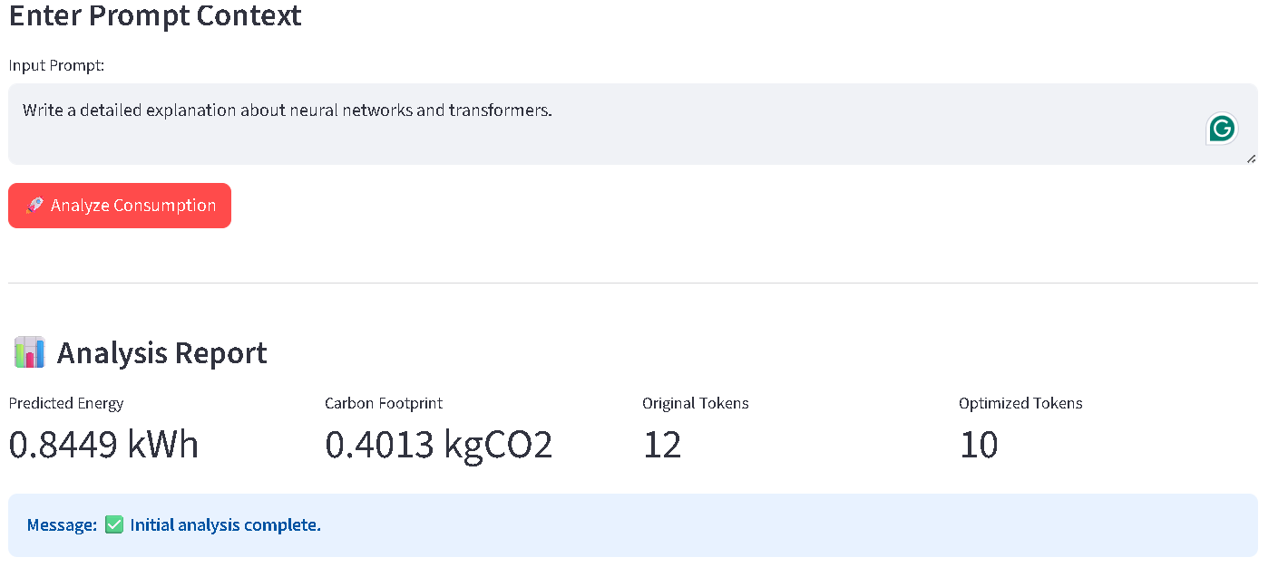
Initial Analysis

Slide 11
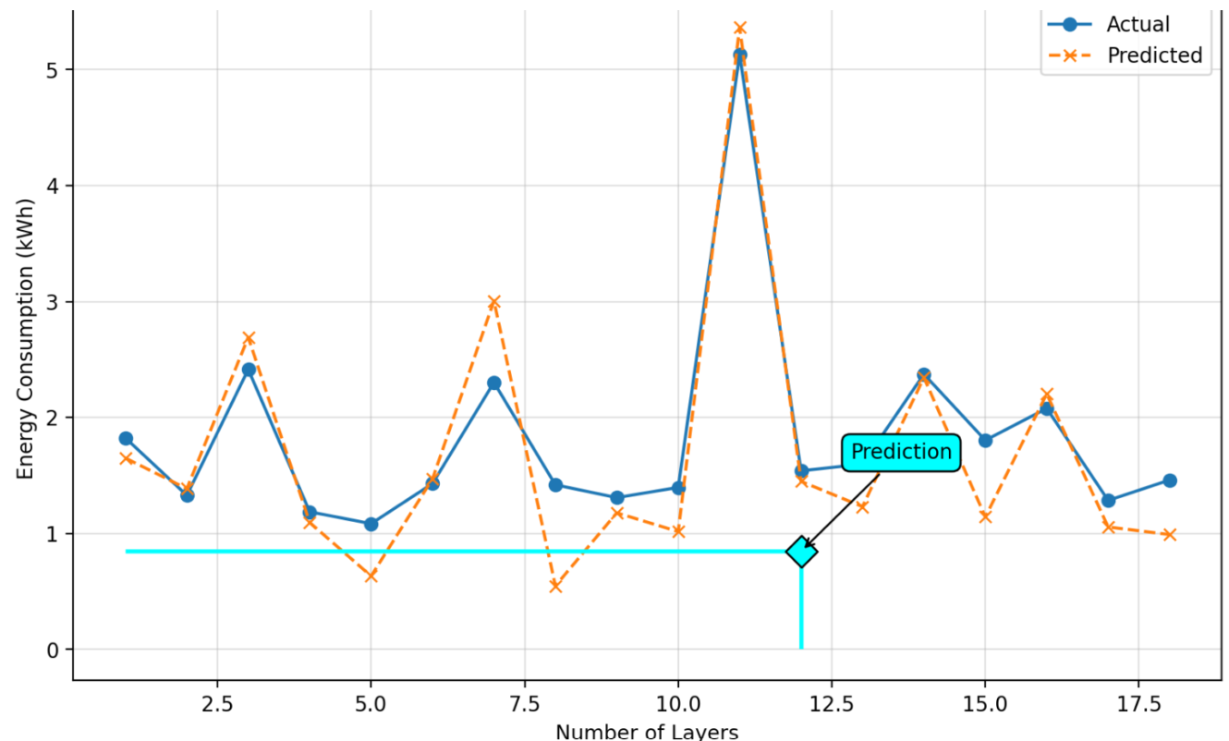
Model performance on the test split
Actual line – Test split
Predicted line – Test split
Predicted data point

Slide 12

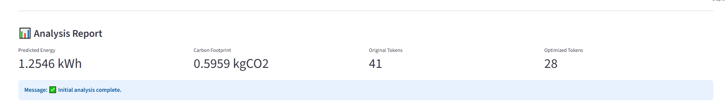
Clear Results
• Auto-saves to model/energy_predictor/
• Separate files per model type
• Includes scalers and metadata
• Loads existing models on startup
• Retrains only when necessary

Slide 13



NLP System Overview
01
02
03
Analyzer
T5 Optimizer
Validator
Calculates token density and linguistic complexity.
Hugging Face T5-small model fine-tuned on 195+ pairs.
Sentence-Transformers ensure semantic meaning is kept.

Slide 14
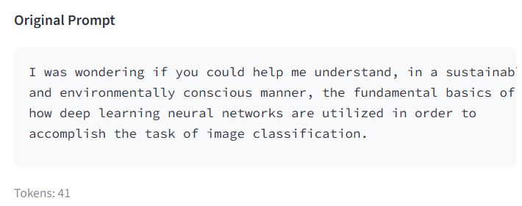
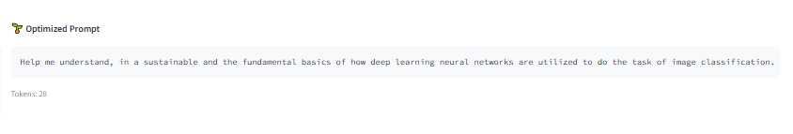
T5 Prompt Optimizer
Intelligent Rewriting
We fine-tuned a T5-small (60M param) model to condense prompts without losing intent.
Removes "politeness padding" (e.g., "Could you please").
Simplifies verbose vocabulary.
Optimized for CPU inference.

Slide 15
Hybrid Fallback Engine
Ensures 100% system availability. If the ML model is offline, rules take over.
Pattern Type | Verbose Input | Optimized Output
Simplification | "In order to facilitate" | "To help"
Vocabulary | "Utilize" | "Use"
Removal | "I was wondering if you could..." | (Removed)
Graceful degradation guarantees the pipeline never breaks.

Slide 16
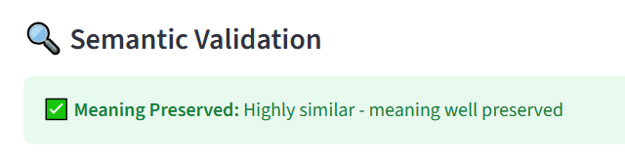
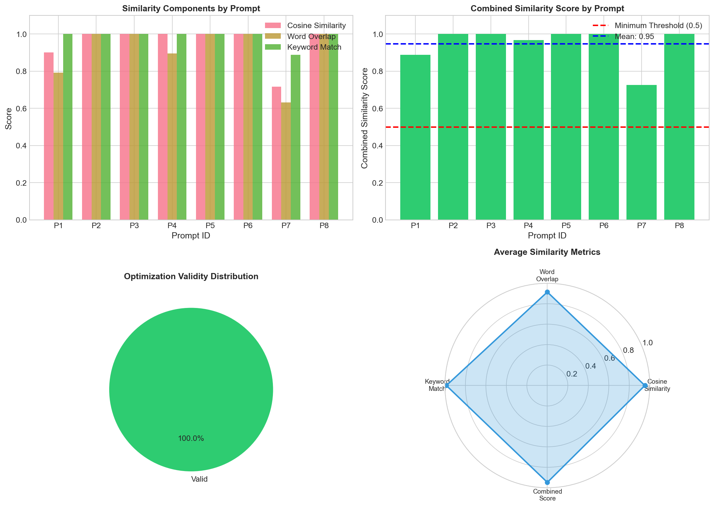


Semantic Validation
The Quality Gate
We don't just shorten text; we verify meaning.
Method: Cosine Similarity of Vector Embeddings.
Threshold: Changes rejected if score < 0.75.

Slide 17
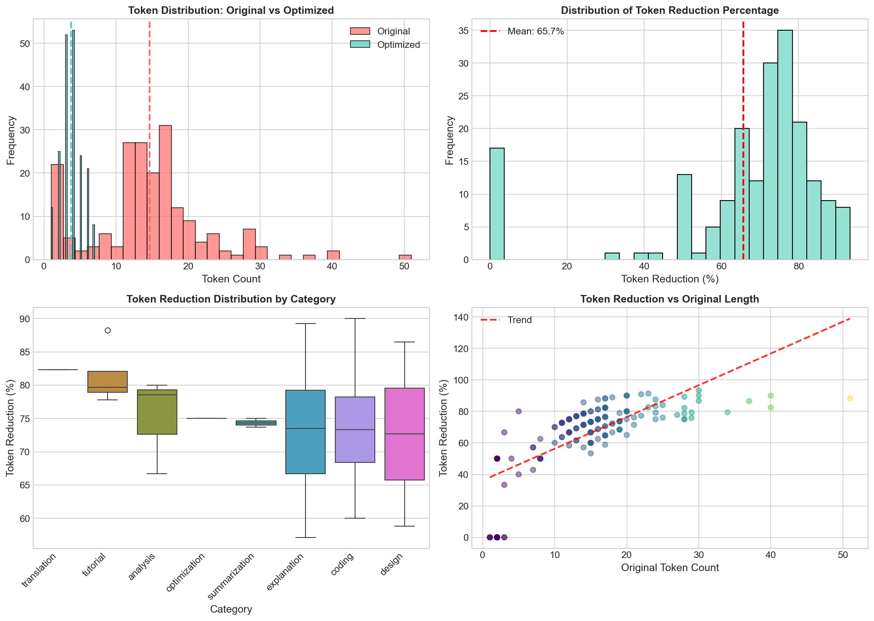

Optimization Results
Impact Analysis
Typical token reduction: 20–40% fewer tokens after optimization.
Semantic similarity usually remains above 85%, keeping user meaning intact.
Energy savings are estimated from token reduction and model parameters.
Quality score combines:
• Token reduction (up to 30 points).
• Semantic similarity (up to 40 points).
• Intent and action preservation (up to 30 points combined).
Rule-based fallback guarantees graceful degradation if ML components fail.
Energy Impact: Linear correlation. Fewer tokens = fewer FLOPs = less energy.

Slide 18
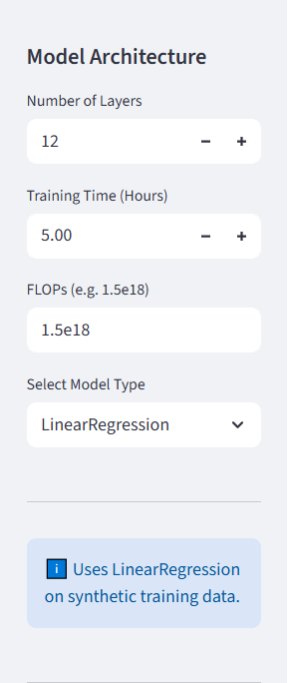
GUI Architecture
Streamlit Implementation
A professional dashboard built in under 500 lines of Python.
Sidebar: Hardware Config (Layers, FLOPs).
Main Stage: Real-time Input & Analysis.
Layouts: Modular components in layout.py.

Slide 19




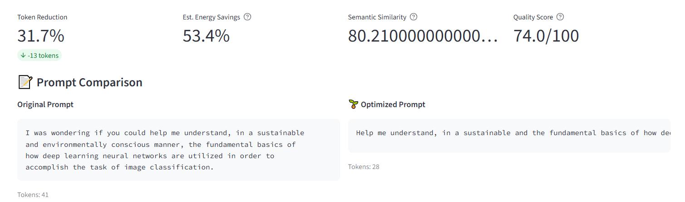
User Interface Features
Config
Analysis
Comparison
Hardware parameters adjustable via Sidebar.
One-click trigger for full ML/NLP pipeline.
Side-by-side view of text changes.

Slide 20
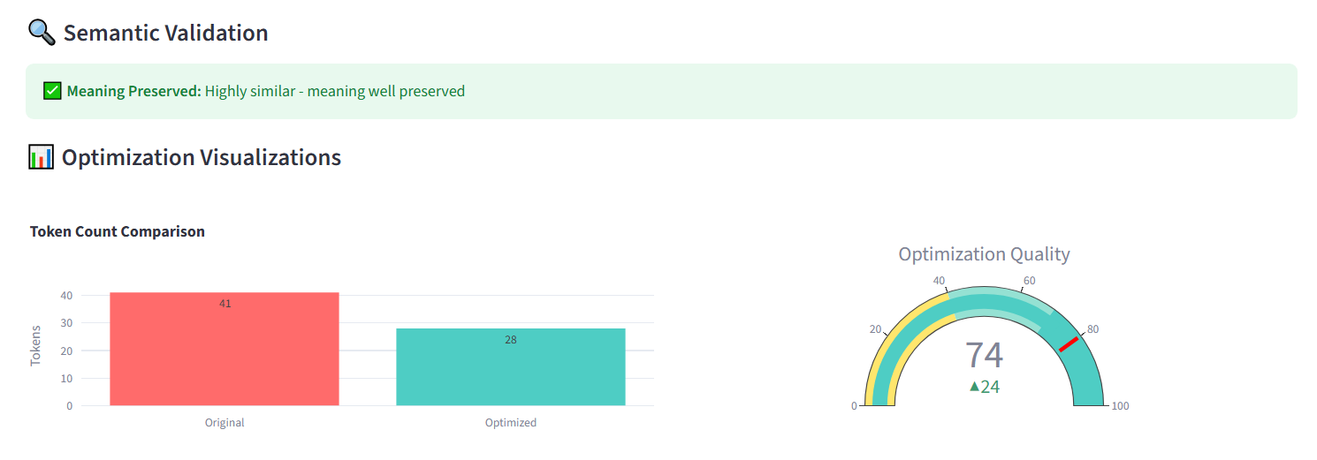
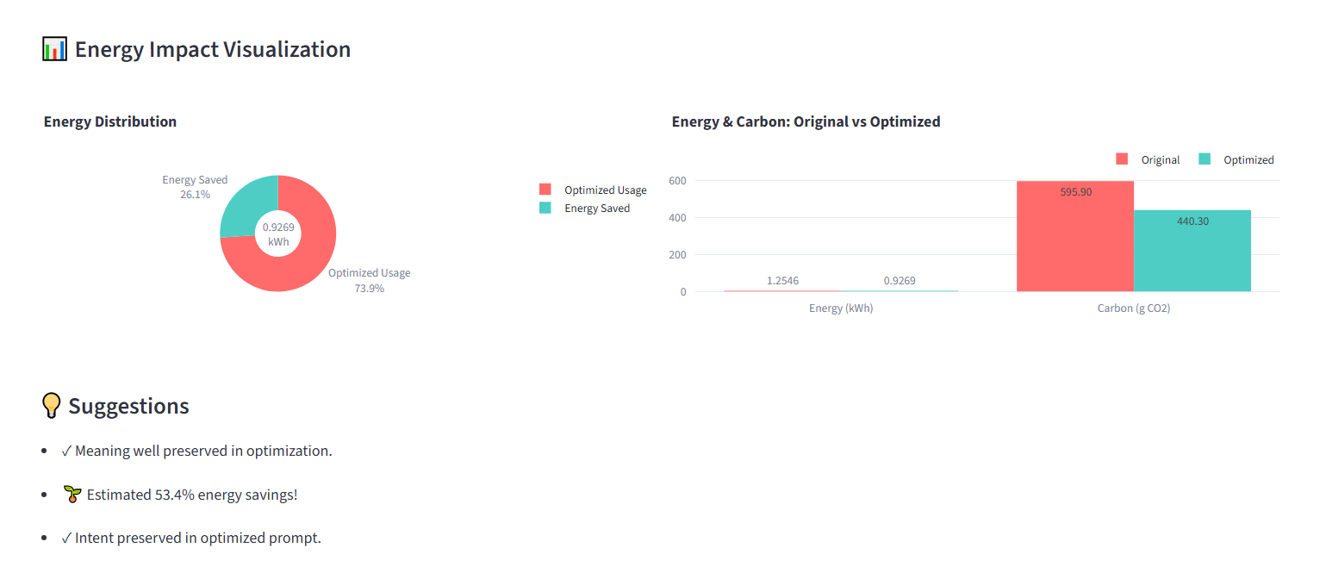
Dashboard Visualizations
Actionable Insights
Turning abstract hardware metrics into concrete sustainability goals.
Energy Distribution Pie Charts
Token Reduction Bar Graphs
Carbon Footprint Counters

Slide 21
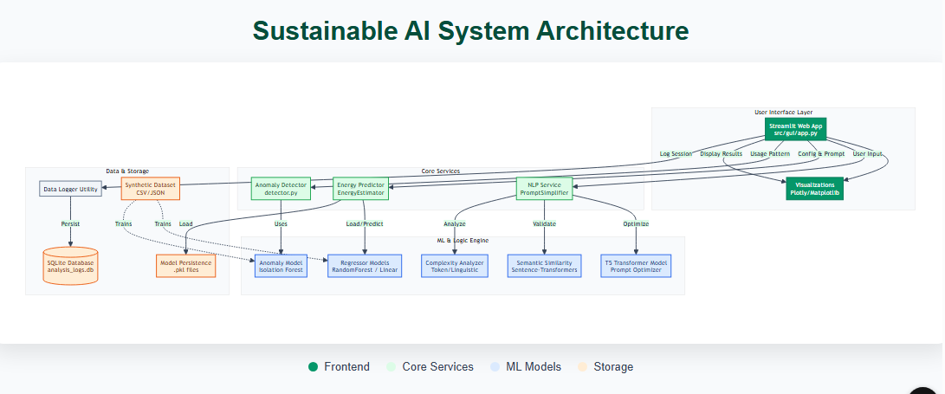
Architecture Diagram

Slide 22

Conclusion & Future Work
Achievements
Roadmap
Functional ML Pipeline
Cloud Deployment
Hybrid Optimization
Live LLM Integration
Real-time Dashboard
Multi-language Support
Democratizing energy transparency for responsible AI.

